Slide 1
NE 763: Advanced Reactor Materials
Fall 2025
Dr. Benjamin Beeler

Slide 2
advanced cladding

Slide 3
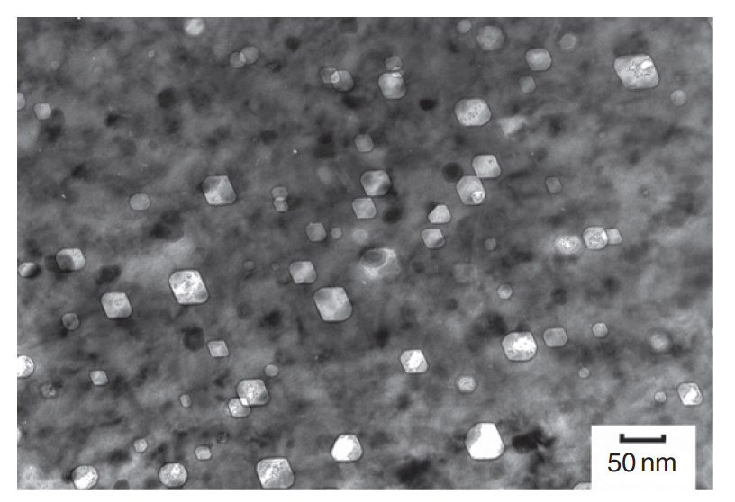
The need for advanced cladding
Austenitic stainless steels are widely used as structural components in nuclear service
At high dose, the microstructure develops a high concentration of voids, leading to dramatic swelling
Swelling of cladding in FFTF and BN-600
Void swelling in 304SS

Slide 4
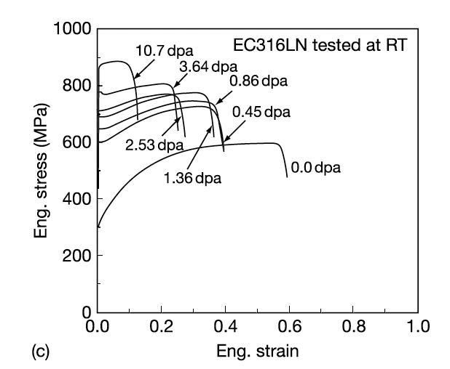
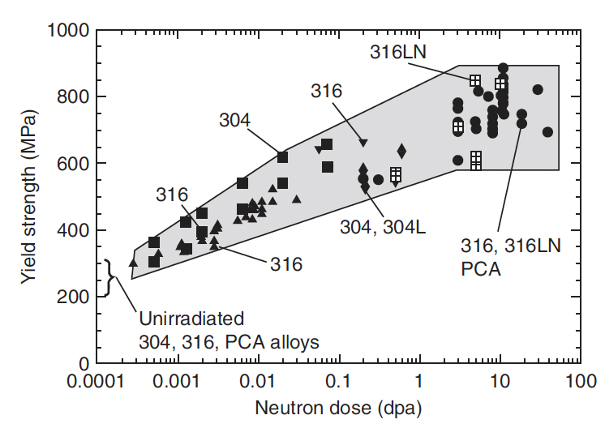
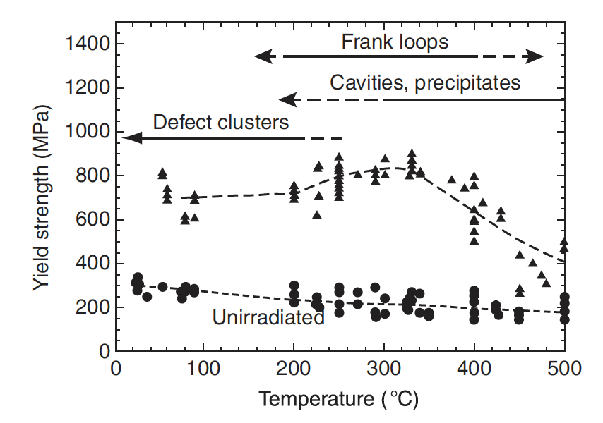
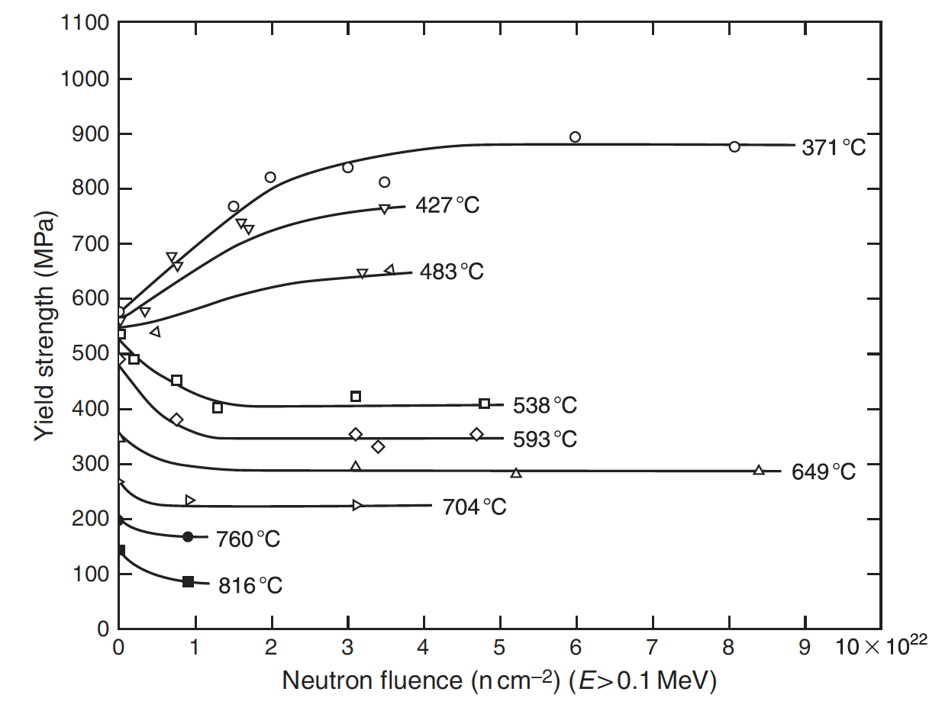
The need for advanced cladding
High fluence can also provide significant radiation hardening, coupled with severe losses in ductility
In addition to high fluence, high temperature contributes to void swelling
SS significantly weakens with increasing temperature
Thus, their applicability is limited in advanced reactor systems where high dose and high temperature are present

Slide 5
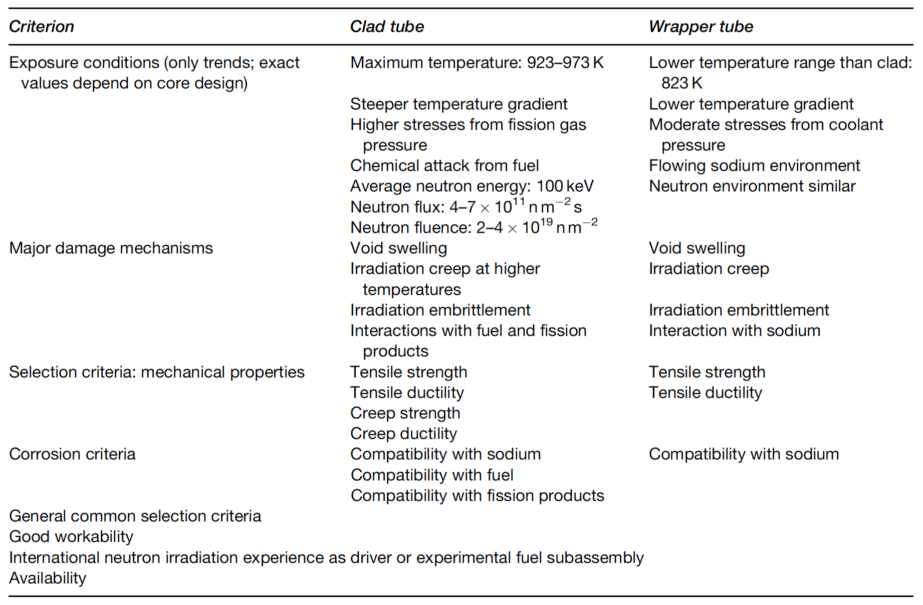
Fast Reactor Conditions
The structural components experience a different environment in advanced fast reactors than those in commercial LWRs
Key phenomena include void swelling, irradiation growth, irradiation hardening, irradiation creep, and helium embrittlement

Slide 6
Ferritic and Ferritic-Martensitic Steels
The advanced ferritic and ferritic–martensitic steels of current interest have evolved from creep-resistant ferritic steels
Subsequent developments through different levels of Cr and Mo have led to the current ferritic and ferritic–martensitic steels: 9–12% Cr–Mo steels
F-M steels have advantageous mechanical properties, are relatively cheap, and control of their microstructure can be performed with heat treatments
F-M steels generally have worse high T mechanical properties than austenitic steels, especially creep life and irradiation creep resistance

Slide 7
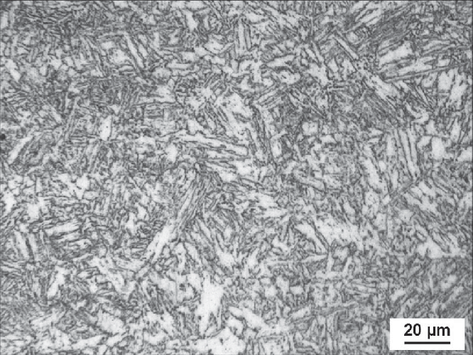
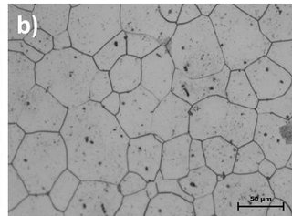
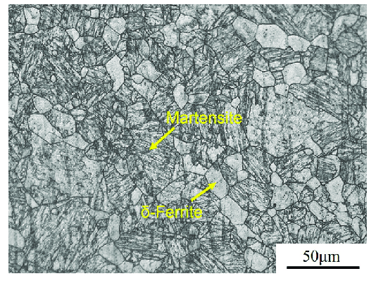
Crystal and Micro Structures
alpha-Fe: ferrite, bcc
gamma-Fe: austenite, fcc
delta-Fe: high temperature ferrite, bcc
martensite: C-rich bct
pearlite: lamellar combination of ferrite and cementite (Fe3C)
also upper and lower bainite: don’t worry about it
alpha’: Cr rich ferrite (mainly induced via thermal aging)
martensite
ferrite
ferrite-martensite

Slide 8
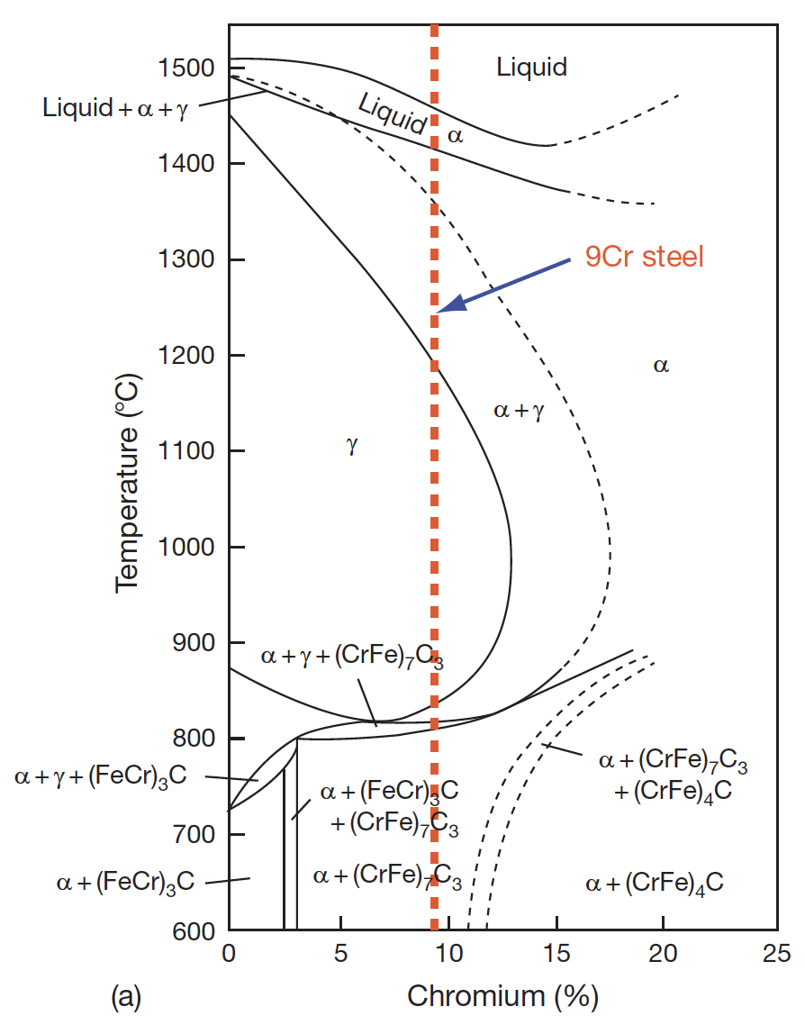
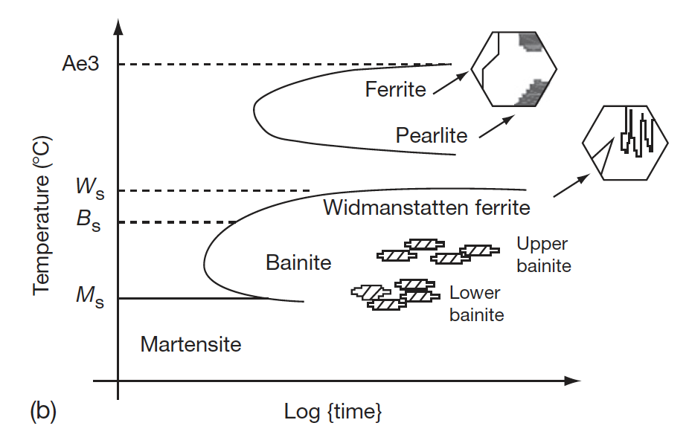
Ferritic-Martensitic Steels
The ability to retain ferrite is dependent upon the alloying elements and the heat treatments
In addition to Cr and Mo, the amount of Si, V, and C affect the phase boundaries
Accordingly, the 9-12% Cr/Mo family of steels can either be martensitic (9Cr–1MoVNb (T91)), ferritic (12Cr–1MoVW (HT9)) or ferritic–martensitic (9Cr–2Mo–V–Nb (EM12)) steel
TTT diagram of austenite
Pseudo-binary phase diagram with Cr equivalent

Slide 9
Composition Effects
The developed of 9Cr-Mo steels was initially focused on oxidation resistance and creep strength
The optimized initial alloy composition considered was 9Cr, 2Mo, 1W, 0.5Si, with C, B, V, Nb, and Ta in small amounts
A reduction in Cr content lowers the oxidation resistance
Higher Cr content has two effects, 1) it increases the hardenability leading to the formation of martensite, and 2) promotes the formation of δ-ferrite, reducing the toughness
If the W+Mo concentration is kept <3%, creep strength will reduce, while higher amount promotes the formation of δ-ferrite and brittle Fe2Mo Laves phase

Slide 10
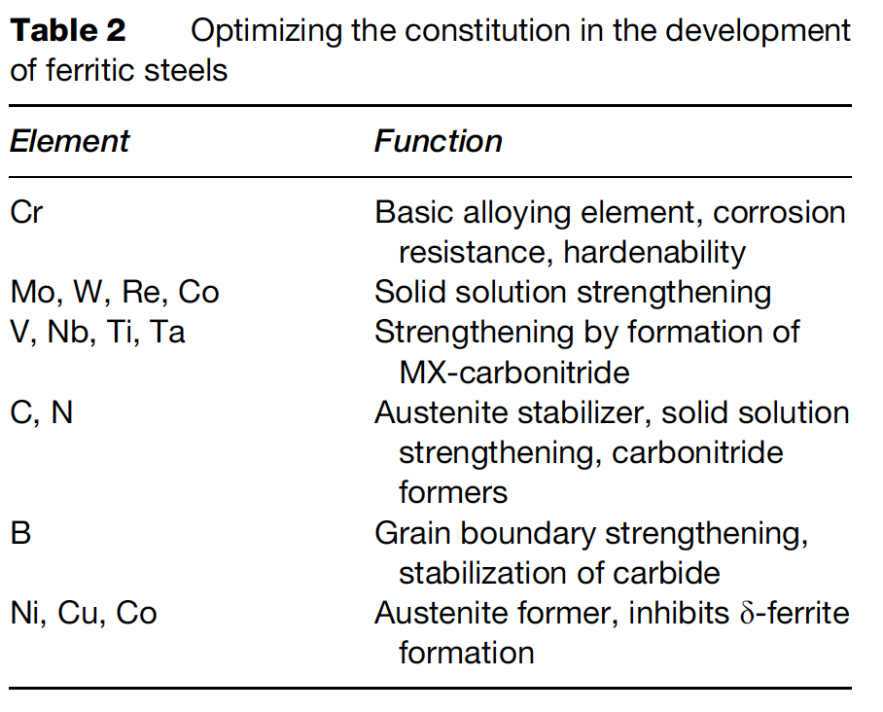
Composition Optimization
The addition or replacement of Mo with W and B increases the stability of M23C6
Lower Ni content introduces δ-ferrite, while its increase reduces creep strength
Lower Si reduces oxidation resistance, while higher Si content leads to agglomeration of carbides
The composition of all other elements can be optimized, based on structure–property correlation studies

Slide 11
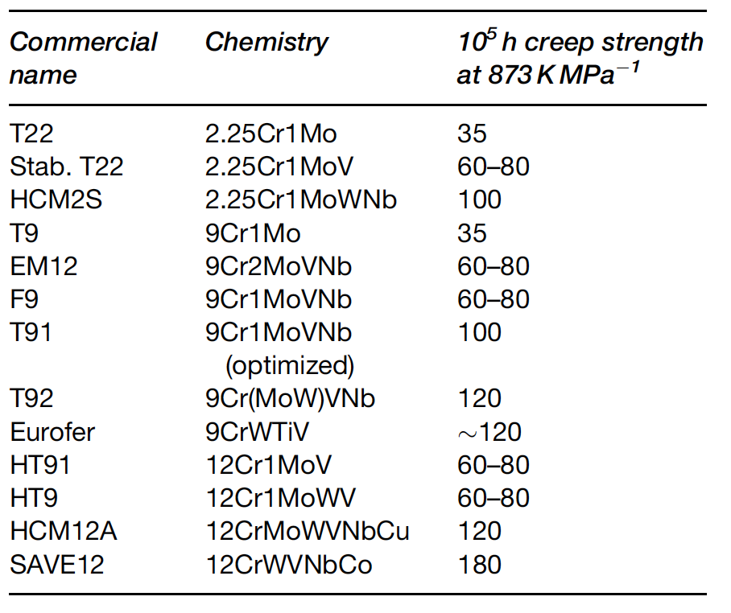
Composition Optimization
The development of high creep-rupture strength steels is based on optimizing the composition, δ-ferrite content, increasing the stability of the martensite, dislocation structure, and maximizing the solid solution and precipitation hardening
Based upon this property tailoring, a large number of alloys have been developed over the last 75 years
Reduced activation ferritic-martensitic (RAFM) steels steels have been developed in order to make concentrations of high activation residual elements lower

Slide 12
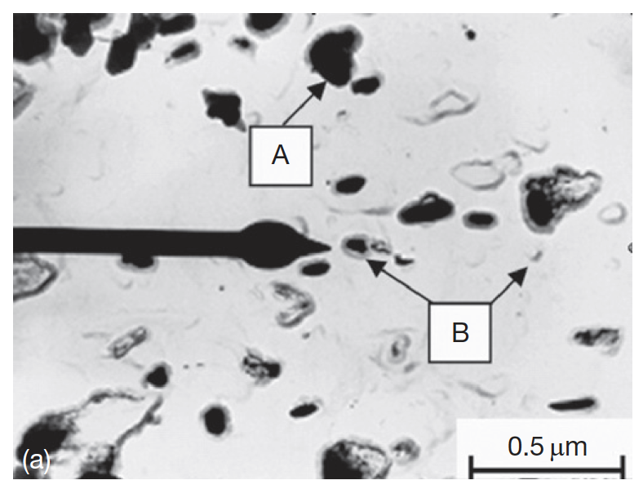
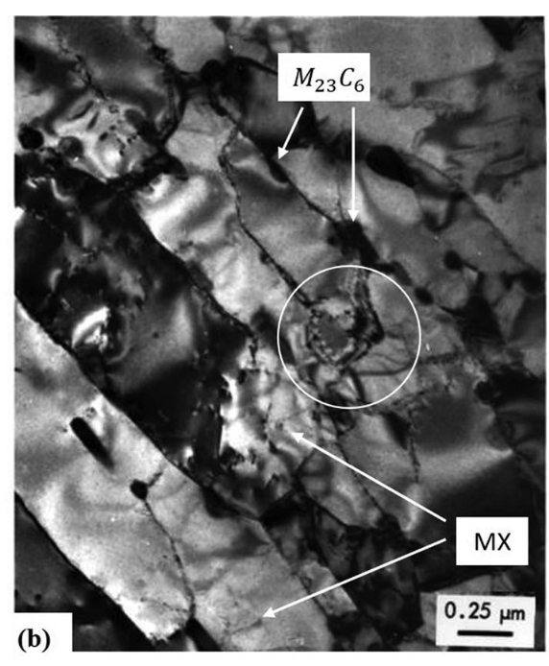
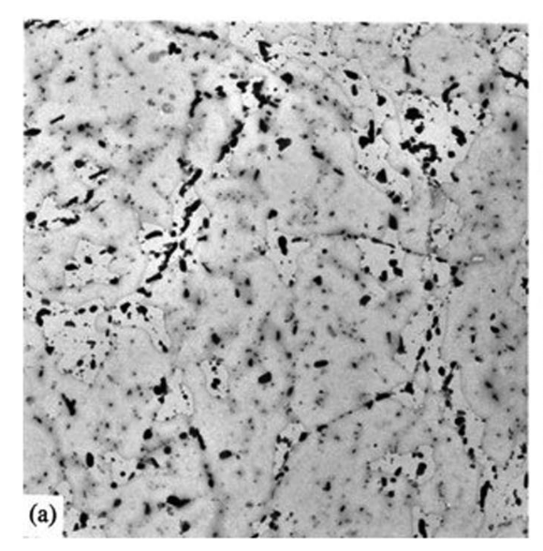
Microstructure
The microstructure of the steels consists of a) martensite laths containing dislocations; b) coarse M23C6 particles located at prior austenite and ferrite grain boundaries; c) finer carbide precipitates found within the laths and at the lath/subgrain boundaries
M2X precipitates rich in Cr also form
HT-9 initial microstructures

Slide 13
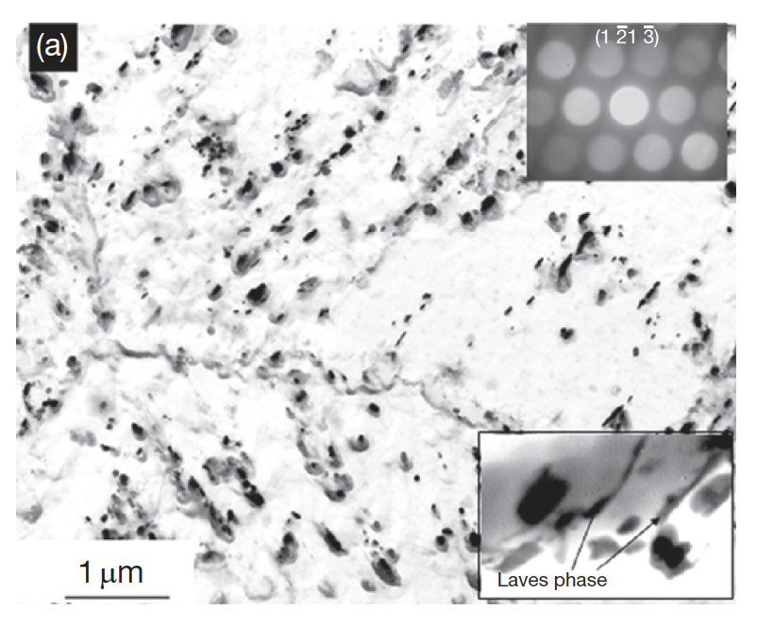
Microstructure
In reactor, this microstructure will change, with the M2X precipitates being replaced by MX intermetallic and Laves phases due to long exposure to high temperature
There are three types of processes with respect to evolution of secondary phases: irradiation-induced precipitation, irradiation-enhanced transformations, and the irradiation modified phases
The evolution of these phases depends on the composition and structure of the steel and the irradiation parameters like the temperature and fluence
Fe2Mo Laves intermetallic phase around the M23C6

Slide 14
Radiation Damage
Dislocation loops are the primary defect species observed
Loops are typically larger and with a lower number density as the irradiation temperature is increased
Loop size and density are increased as a function of dose, with loop density potentially saturating at 10 dpa
Voids can also form above 400C
Radiation-induced segregation can occur in these steels, but has been significantly less studied than in austenitic steels
General consensus that Cr is depleted at interfaces, and Ni, Si , and P are enriched at sinks
RIS appears to be dependent on both irradiation dose and temperature

Slide 15
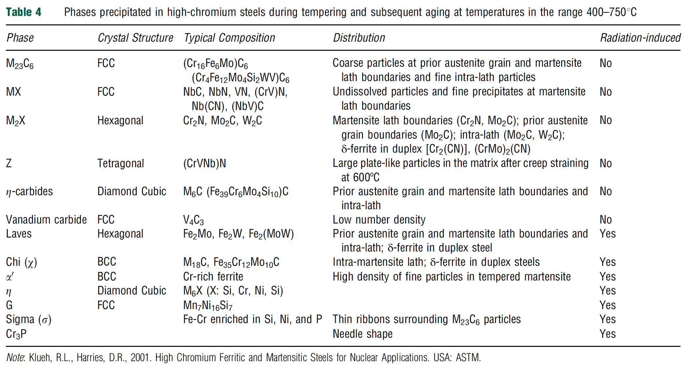
Phase Precipitation
Thermal processing will lead to precipitation, which affects the mechanical properties
Most of the carbon forms in M23C6 precipitates, which increase strength and reduce ductility
RIS leading to Cr depletion increases the matrix composition and can lead to alpha’ formation, which embrittles the material
Chi, G, and sigma phases are enriched in Si and Ni and can nucleate at interfaces

Slide 16
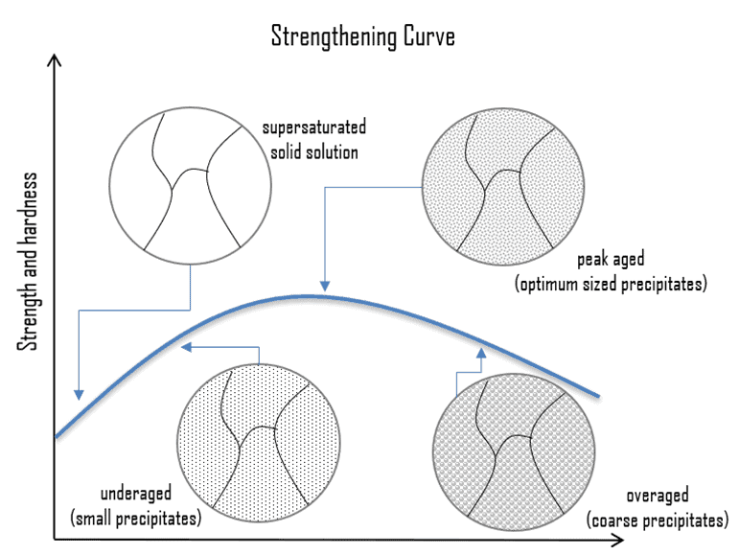
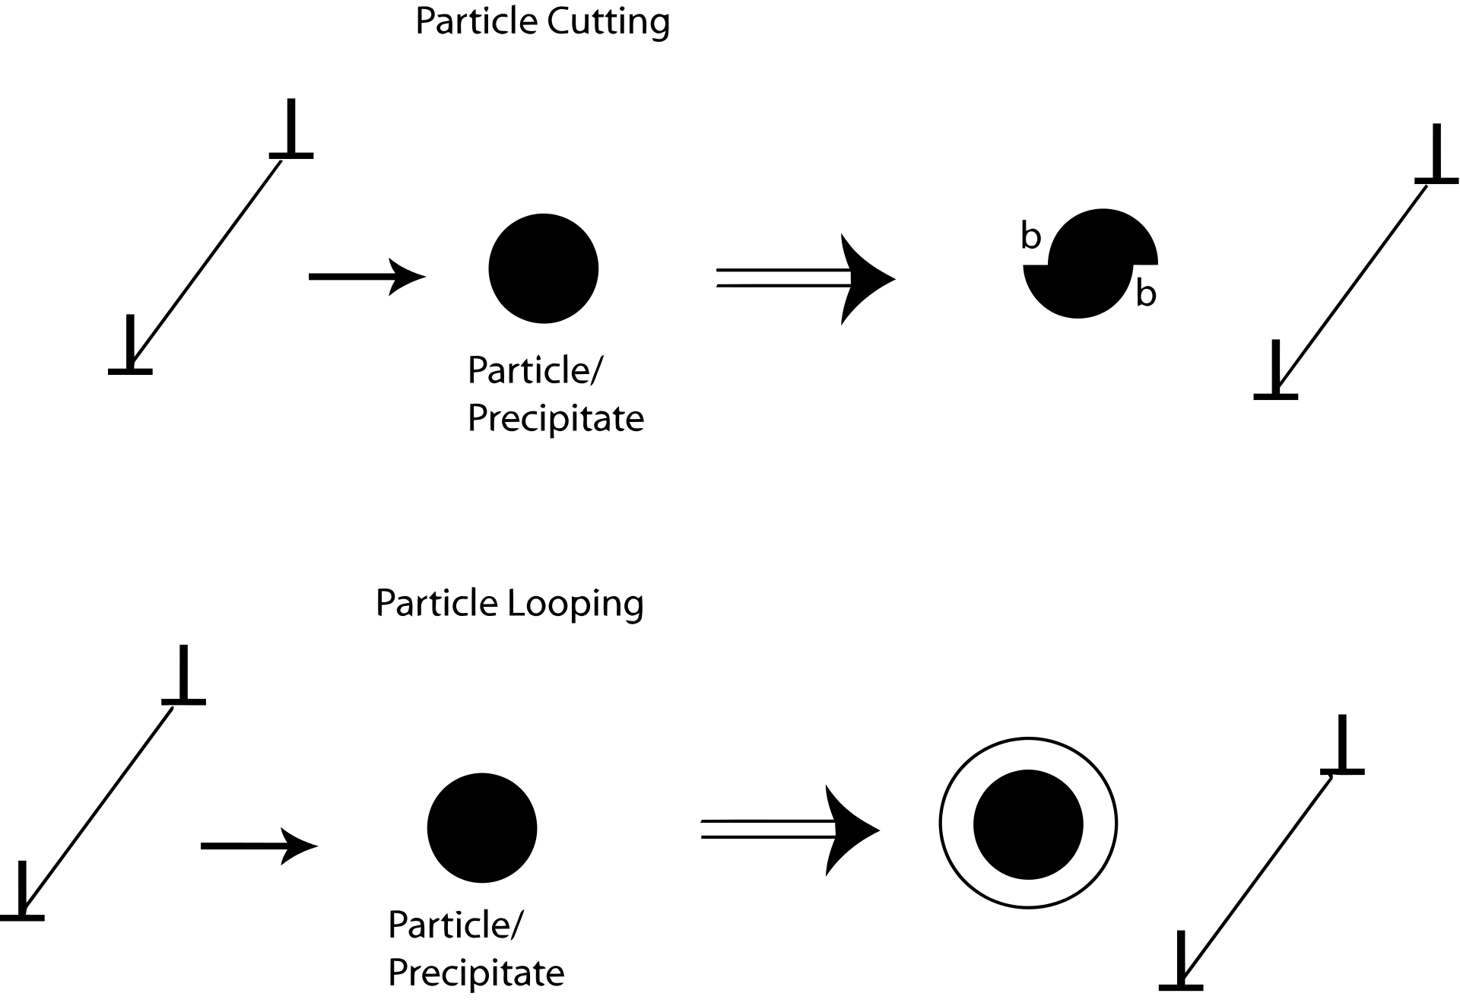
Precipitate Hardening
Precipitation hardening relies on changes in solid solubility with temperature to produce fine particles of an impurity phase which impedes the movement of dislocations
Since dislocations are often the dominant carriers of plasticity, this serves to harden the material

Slide 17
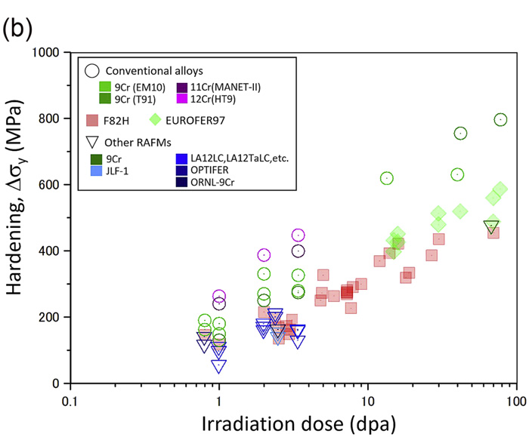
Irradiation Hardening
Microstructure changes lead to irradiation hardening of the steel
High amounts of carbon in 12% Cr steels leads to a large amount of precipitation, up to twice as much as 9% Cr steels
This high carbon content is needed to use steels as martensite
Both the steels have mainly M23C6 carbides with a small fraction of monocarbides
This high concentration of precipitates can eventually lead to brittle failure
The critical stress is inversely proportional to the crack length, crack length is equal to the diameter of the carbide precipitate, thus fracture stress also decreases with increasing precipitate size

Slide 18
Irradiation Creep Resistance
Irradiation creep resistance needs a good combination of thermal creep behavior and long-term microstructural stability at high temperature
In order to fabricate creep resistant steels, you design to have a number of microstructural features that are present
Introduce high dislocation density to increase the strength of the basic lattice
Strengthen the host lattice by solid solution strengtheners or defects
Stabilize the boundaries created by phase transformations by precipitating carbides along the boundaries
Arrest dislocation glide and climb by selection of crystal structure, solid solution, interfaces, dislocation interactions
Resist sliding of grain boundaries by introducing special types of boundaries and anchoring the boundaries with precipitates

Slide 19
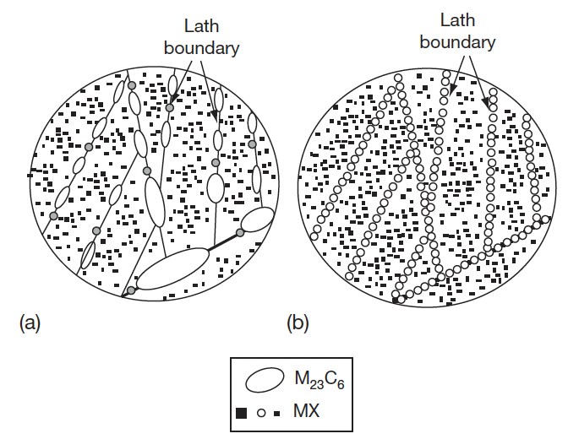
Irradiation Creep Resistance
Ensure long-term stability of the microstructure, especially against recovery and coarsening of the fine second phase particles
In the case of 9–12 Cr steels, the martensitic lath structure decorated with only MX which should be stable over long-term service life is the most desired structure
MX can be stabilized over M23C6 by reducing the carbon content, but we need high amounts of C to have appropriate high temperature behavior
undesirable
desirable

Slide 20
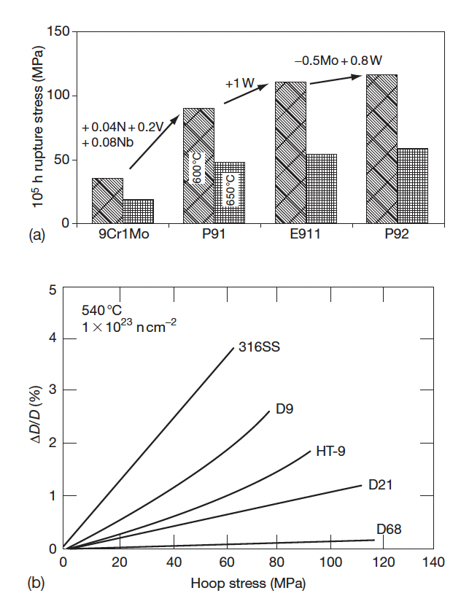
Irradiation Creep Resistance
So careful tailoring of alloying elements has led to improvement of the creep strength
Thermal creep behavior provides a starting point, which can then be refined by studying creep under irradiation
The irradiation creep depends on the stress level, the temperature, and the dose
Thermal Creep
Irradiation Creep

Slide 21
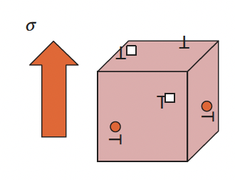
Irradiation Creep Resistance
The excess point defects precipitate into either interstitial or vacancy loops, but not randomly
The interaction between point defects and stress leads to the precipitation of interstitial loops parallel to the applied stress, while vacancy loops form in planes perpendicular to the stress: stress-induced preferential nucleation (SIPN)
Under applied stress, the vacancies migrate preferentially to grain boundaries perpendicular to the applied stress, while the interstitials toward boundaries parallel to the stress: stress-induced preferential absorption (SIPA)
SIPN
SIPA

Slide 22
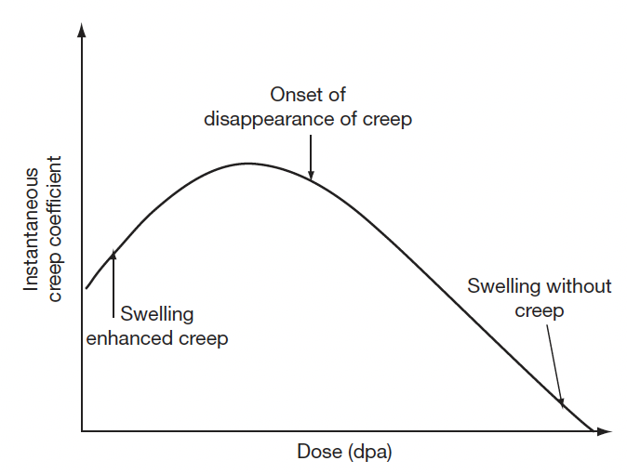
Creep Evolution
The radiation-induced defects also evolve from isolated point defect to loops and voids, which have different types of influence on irradiation creep
Irradiation creep occurs simultaneously with swelling and swelling can influence irradiation creep
At very small dose levels, swelling enhances creep rates; beyond a certain dose level the creep component reduces; at high dose levels creep disappears, while swelling continues

Slide 23
Irradiation Embrittlement
Ferritic steels have a large number of monocarbides which aid in creep resistance
The lath boundaries are decorated with Cr rich M23C6 precipitates which increase the thermal stability
Embrittlement is caused by 1) segregation of elements to lath boundaries which make the grain boundaries decohesive, and 2) evolution of carbides and intermetallic phases
For removable components such as cladding, which are subjected to high temperature and pressure with a residence time of a few years, creep is the issue which decides their design and performance
For permanent support structures increase in hardening and loss in fracture toughness on irradiation are major issues

Slide 24
Irradiation Embrittlement
The increase in the ductile to brittle transition temperature, DBTT, is known to be related to irradiation hardening, which is generally observed to saturate with fluence
Evidence for a possible maximum in DBTT was observed for the 12Cr steel irradiated in the range of 35–100 dpa in the FFTF
High fluence and/or high temperature are required before a maximum is observed
Thus, these properties are a balance between the point defect production and irradiation-induced precipitation
The precipitation during irradiation hardens the steel and irradiation accelerated recovery and aging soften the steel
The high temperature recovery produces an observable saturation in hardening above ~720K

Slide 25
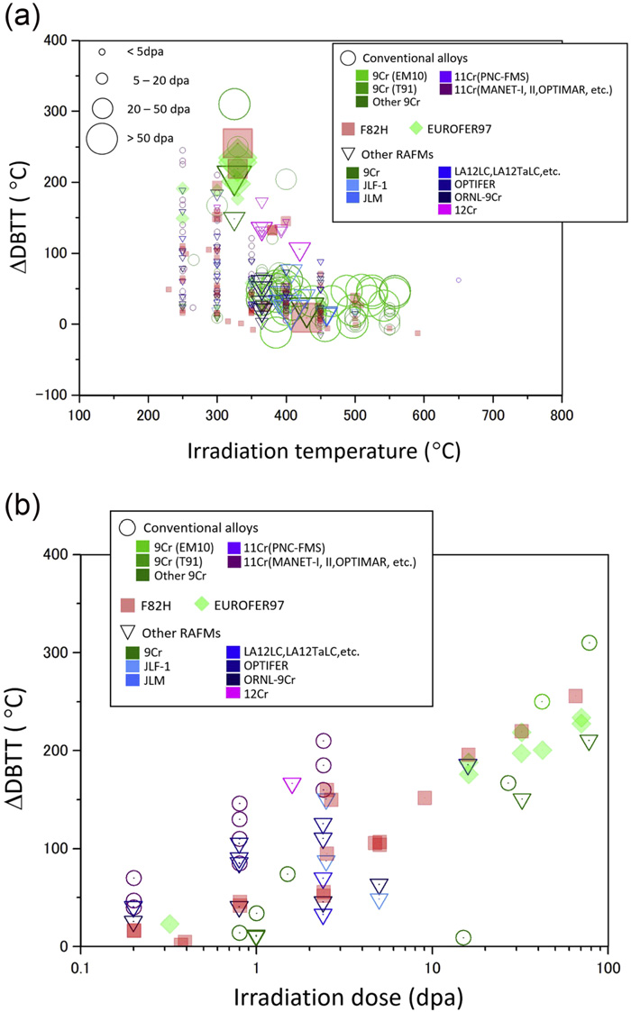
DBTT Changes

Slide 26
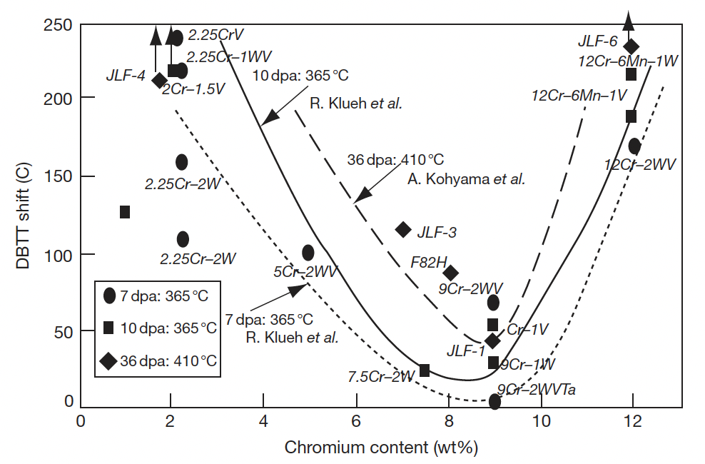
DBTT
BCC materials can undergo significant increase in the DBTT at low T for even 1 dpa
The minimum operating temperature to avoid embrittlement F/M steels is ~500 K
Extensive evaluation of the embrittlement behavior of the ferritic steels for different compositions has been performed
Compositions around 9Cr show the least change in the DBTT, and addition of phosphorous, copper, vanadium, aluminum, and silicon increase the DBTT
The 12Cr steels, like HT9, show a larger shift in DBTT as compared to modified 9Cr–1Mo steel, balancing between swelling resistant 12Cr steels and 9Cr steel which is less prone to embrittlement than 12Cr steels

Slide 27
Features affecting Embrittlement
There are a number of microstructural features that can impact the embrittlement of F/M steels
Prior austenite grain size (PAGS)
The size of martensitic lath and packet (which is sensitive to austenitization temperature)
Tempering/annealing, which can increase carbide precipitate size
The generation of helium through (n,alpha) reaction

Slide 28
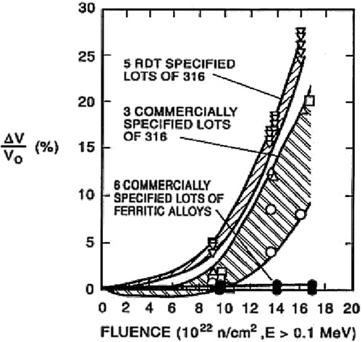
Void Swelling Resistance
Ferritic steels were experimentally observed to exhibit superior radiation resistance compared to austenitic steels, which is largely based on their low swelling behavior
The 9Cr–1Mo steel, modified 9Cr–1Mo (Grade 91), 9Cr–2Mo, and 12Cr–1MoVW (HT9) have low swelling rates at doses as high as 200 dpa
The threshold dose for swelling in ferritic steels is as high as nearly 200 dpa, compared to 80 dpa for the present generation austenitic stainless steel
HT9 shows 1% swelling at 693 K for 200 dpa

Slide 29
Void Swelling
Void swelling depends crucially on the structure of the matrix lattice, in which irradiation produces the excess defects
There are several reasons why the swelling resistance in ferritic steels is lower than austenitic steels
First, the relaxation volume for interstitials is large in ferrite than in austenite
Thus, for a given interstitial, the strain field is larger in ferrite, which has the impact of more strongly repelling other interstitials, and more strongly attracting vacancies
Second, the migration barrier of vacancies in ferrite is much lower than in austenite (0.55 eV to 1.4 eV)
Since vacancies are more mobile in ferrite, recombination is more likely with the dispersed isolated interstitials
Third, excess vacancies can be trapped at carbide particles, of which there is a high number density, as the C-vacancy binding energy in ferrite is twice that in austenite

Slide 30
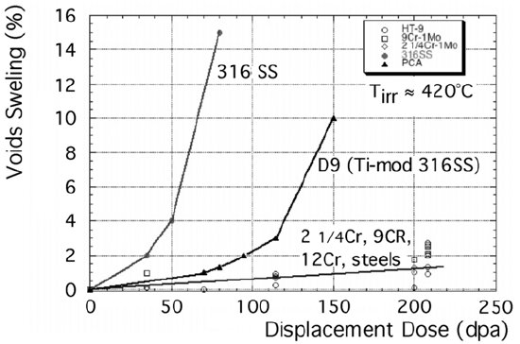
Void Swelling
Fourth, the way dislocations and solutes interact in ferrite makes them strong sinks, generating strain fields that attract vacancies and provide a high sink density
Finally, the complex microstructure of martensite laths and a ferrite matrix inherently produces a very high density of sinks, with some arguing the fundamental microstructure of F-M steels governs the improved swelling behavior
Some combination of all of these factors likely contribute

Slide 31
Ferritic/Martensitic Steels Summary
Austenitic steels undergo excessive void swelling in fast reactor conditions
F/M steels have good mechanical properties, are cheap, and their microstructure can be tailored through composition and fabrication
M23C6 and monocarbide precipitate are prevalent both along grain boundaries and within the grains
Tailoring of alloying elements has allowed for improved creep strength
Embrittlement is caused by segregation of elements to lath boundaries and evolution of precipitates
DBTT shift is minimized for 9Cr steels
F/M steels swell very little, one of the key features making them suitable for application

